Slide 1
TED Talks as a Tool for Effective and Enjoyable IELTS Preparation
Marianna Lisna

Slide 2
SPEAKING
1. Describe your favourite work of art. You should say:
what it looks like;
who it was created by and when;
how it makes you feel
and explain what makes it so special for you.
2. Discuss in small groups:
Why do people become professional artists?
Do you think today’s artists are as good as those who lived hundreds of years ago?
Why is art so expensive?
What would life be like without art?
WRITING
Write an essay about the following topic:
Advances in science and technology have made great changes to lives of ordinary people, but artists such as musicians, painters and writers are still highly valued. What can the arts tell us about life that science and technology cannot?

Slide 3
Discuss with your neighbour ☺
What problems might learners have with these tasks?
How can these problems be handled?

Slide 4
Problems
I don’t know what to say.
I’ve never thought about it.
This topic is not interesting for me.

Slide 5
Knowledge of the World
Foreign language teaching is often able to assume that learners have already acquired a knowledge of the world sufficient for the purpose. This is, however, not by any means always the case (CEFR).

Slide 6
Discuss with your neighbour ☺
What knowledge of the world is a successful IELTS candidate supposed to possess?
How to determine the level of this knowledge?
How to equip the learner with the missing knowledge of the world in the course of preparation to the test?

Slide 7
IELTS Domains
Advertising
Art
Biology
Chemistry
Cyber crime
Economics
Education
Environment
Geology
Globalization
Health
History
Justice
Linguistics
Neuroscience
Technology
Transport
Philology
Psychology
Sociology
Sport, etc.

Slide 8
Key questions
How to enable learners to operate successfully within unfamiliar domains?
How to raise students’ interest in an array of themes not related to what they do / think about every day?

Slide 9
TED Talk. Taking imagination seriously (Janet Echelman)

Slide 10
TED Talk. Taking imagination seriously (Janet Echelman)

Slide 13
TED Talks (https://www.ted.com)
Do schools kill creativity?
Four lessons in creativity
How giant web sites design for you
How to make stress your friend
How to speak so that people want to listen
How to spot a liar
Lessons in business from prison
Life lessons from an Ad Man
Make up new words
This is what happens when you reply to spam email
The history of the world in 10 minutes
Your brain is a supercomputer

Slide 14
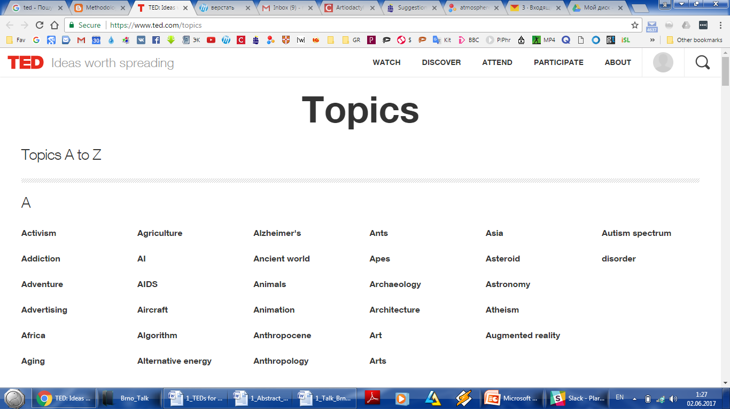

Slide 15
Rationale of using TED talks
Authentic
Numerous
Diverse
Interesting
Up-to-date
Subtitles available
High-level vocabulary
Enable to alleviate ‘heavy’ topics in the IELTS Academic Exam;
Effectively develop language skills and sub-skills

Slide 16
Vocabulary
high-level vocabulary
focus on fixed and semi-fixed items
pre-teach new lexis:
gap-fill
matching
discuss the meaning
https://drive.google.com/file/d/0B3HVeEn0WUHraEhrcEFKenhCZnc/view?usp=sharing

Slide 18
Listening
authentic language
various accents
development of various listening sub-skills
gist
detailed information
during-tasks:
comprehension questions
true / false statements
matching
gap-fill
mistakes correction. etc.
https://drive.google.com/file/d/0B3HVeEn0WUHrNHBVUVBVTUFRajA/view?usp=sharing

Slide 19
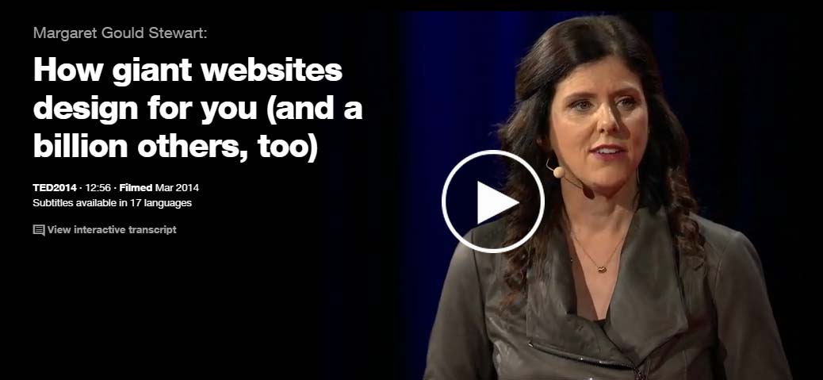

Slide 20
Reading
TEDs cover a very wide range of topics, including scientific ones
activate Ss’ schema, generate interest in further reading:
https://drive.google.com/file/d/0B3HVeEn0WUHrc3d2LTZfYjFOQlU/view?usp=sharing

Slide 23
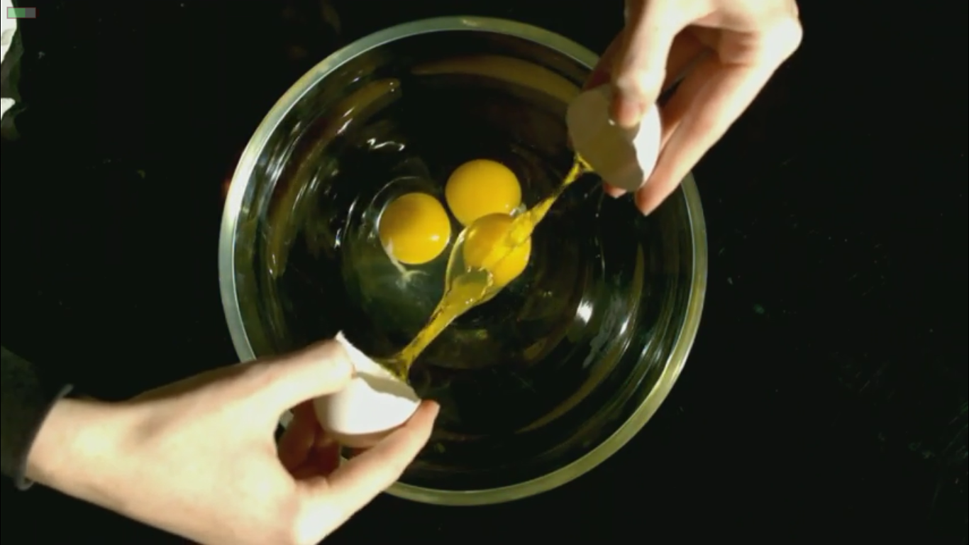
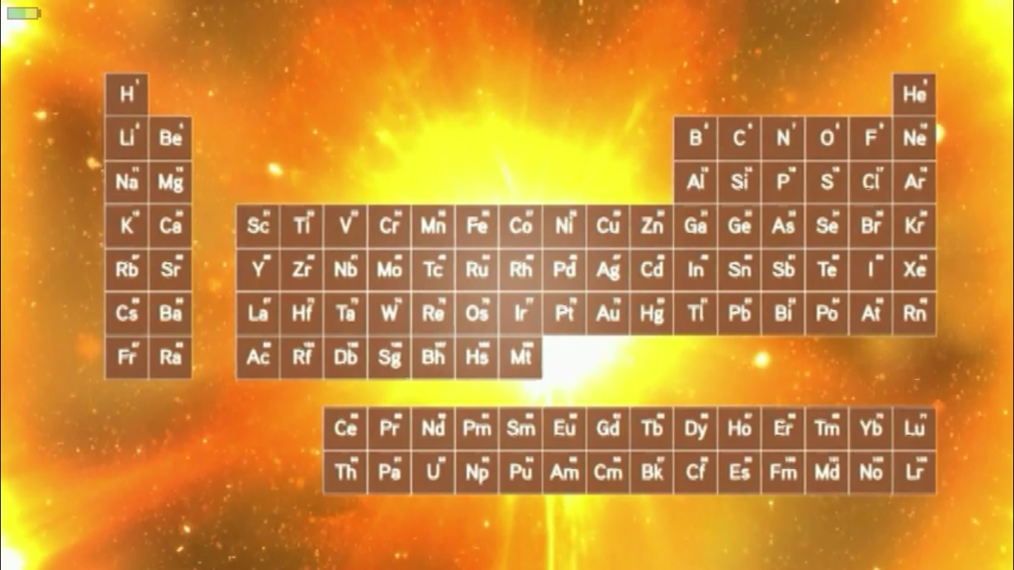

Slide 24
Writing
increase Ss’ creativity
serve as a springboard into writing assignments
https://drive.google.com/file/d/0B3HVeEn0WUHrZEFQZHpzQUZfbEE/view?usp=sharing;

Slide 25
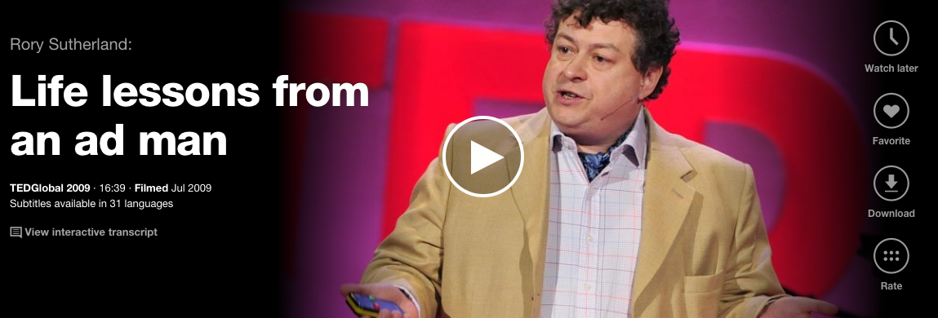

Slide 26
Speaking
Lead-in
IELTS Speaking Task 1 or Task 2
Post-task
IELTS Speaking Task 2 or Task 3
https://drive.google.com/file/d/0B3HVeEn0WUHrX2hPNWF4X0RpYnc/view?usp=sharing.

Slide 27
Creating a Lesson Plan. Workflow
Choose the video referring to some IELTS thematic area.
Scan the script of the video for potentially difficult words in order to pre-teach them.
Divide words into various groups depending on their method of presentation or practising.
Split the video into several segments based on its thematic structure.
Define the highlights in each segment on which the comprehension task will be based.
Plan the sequence of the lesson, i.e. lead in, video comprehension and production activities.

Slide 29
Lesson Plan
Pre-tasks:
speaking (part 1 or 2)
pre-teach essential vocabulary
During-tasks:
listening comprehension
Post-task
vocabulary extension
speaking (part 2 or 3)
writing

Slide 30
Extensive watching / listening
Each S chooses a certain domain
In class: make a mind map of the chosen domain / what I know – what I’d like to know
Homework: watch 5 videos about the topic, take notes (new / surprising / strange, etc.), complete your mind map
In class: Ss share there findings, review other Ss’ mind maps, recommend each other the best videos

Slide 31
If we, as teachers, aim to turn students into independent learners and users of the English language, we are equipping them not just for the exam, but for their future careers and lives.
Sam McCarter

Slide 32
Conclusion
Taking the IELTS Academic Exam successfully requires some world knowledge.
This extra-linguistic competence can be enhanced along with the core exam skills by means of TED Talks.
TED Talks make a change, since they enable teachers to shift the focus from certificate acquisition to language acquisition.

Slide 33
Thank you! ☺
marianna1983@yandex.ua
m.lisna@karazin.ua

